Slide 1
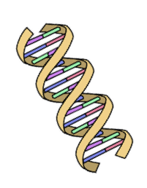
Computational Biology

Slide 2
We can read the DNA in your cells
T
A
C
G

Slide 3
How tall is the human genome if you print it on paper?
424 feet
305 feet
Notes:
The human genome consists of approximately 3.1467 billion base pairs (a number just slightly less than the number of seconds in 100 years: 3.15576 billion). Thus, 1,206,980 single-sided sheets would be needed to display the entire human genome in this way. A modern ream of printer paper consists of 500 sheets of paper and is about 2.1" (5.33 cm) thick. One would therefore need to use 2,414 reams of paper to print the human genome in the format just described. A stack of that many reams of paper would stand 424.4 feet (129.36 m) tall, approximately midway in height between the Statue of Liberty and the Washington Monument:
http://bio4.us/biotrends/human_genome_height.html
So how do you think we can read through all these sheets of paper?

Slide 4
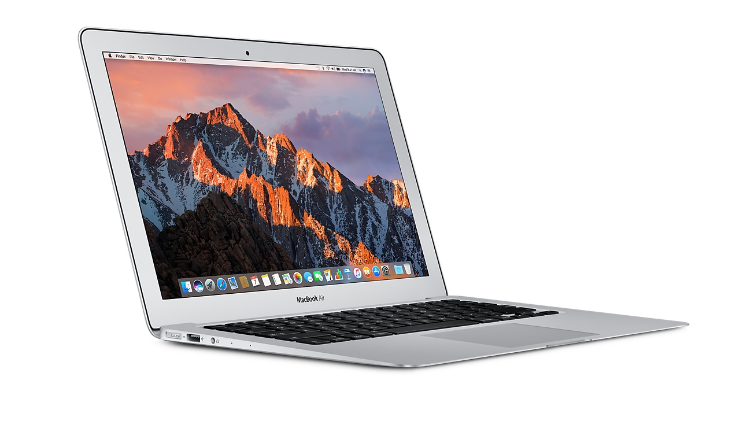
Notes:
We use a computer
Has anyone heard of big data?
We as scientists use computers to do our research
We can use computers to read through the big data that is all the genome sequence and look for patterns that cause disease
Our lab studies heart disease

Slide 5
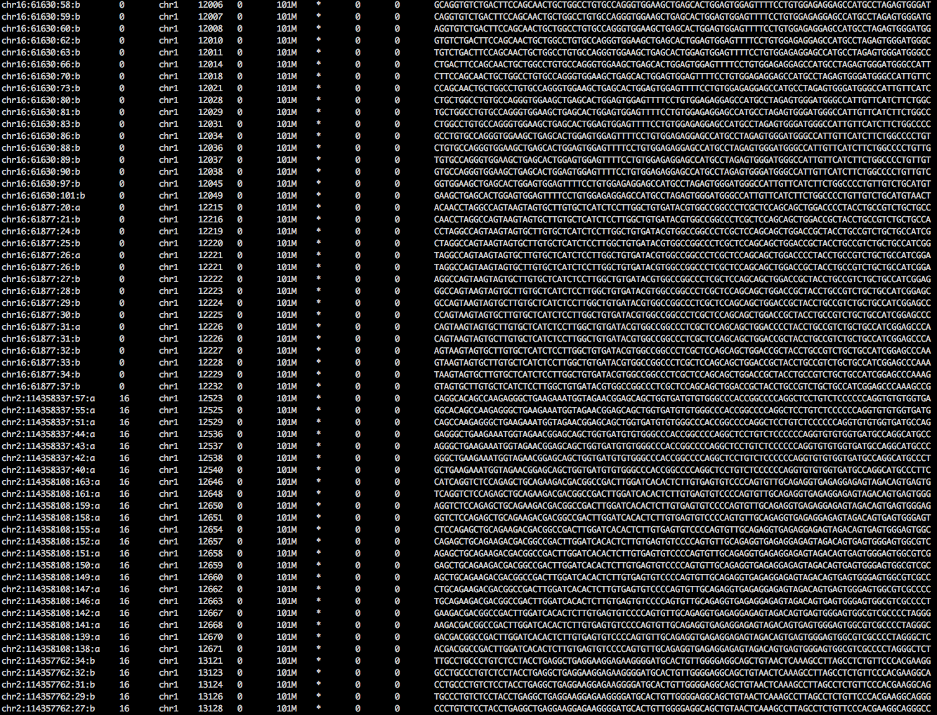
A
T
C
G
Notes:
This is an example of what the DNA sequence looks like when I read it on my computer
I can count how many times I see an A T C or G and look for patterns in a person’s genome

Slide 6
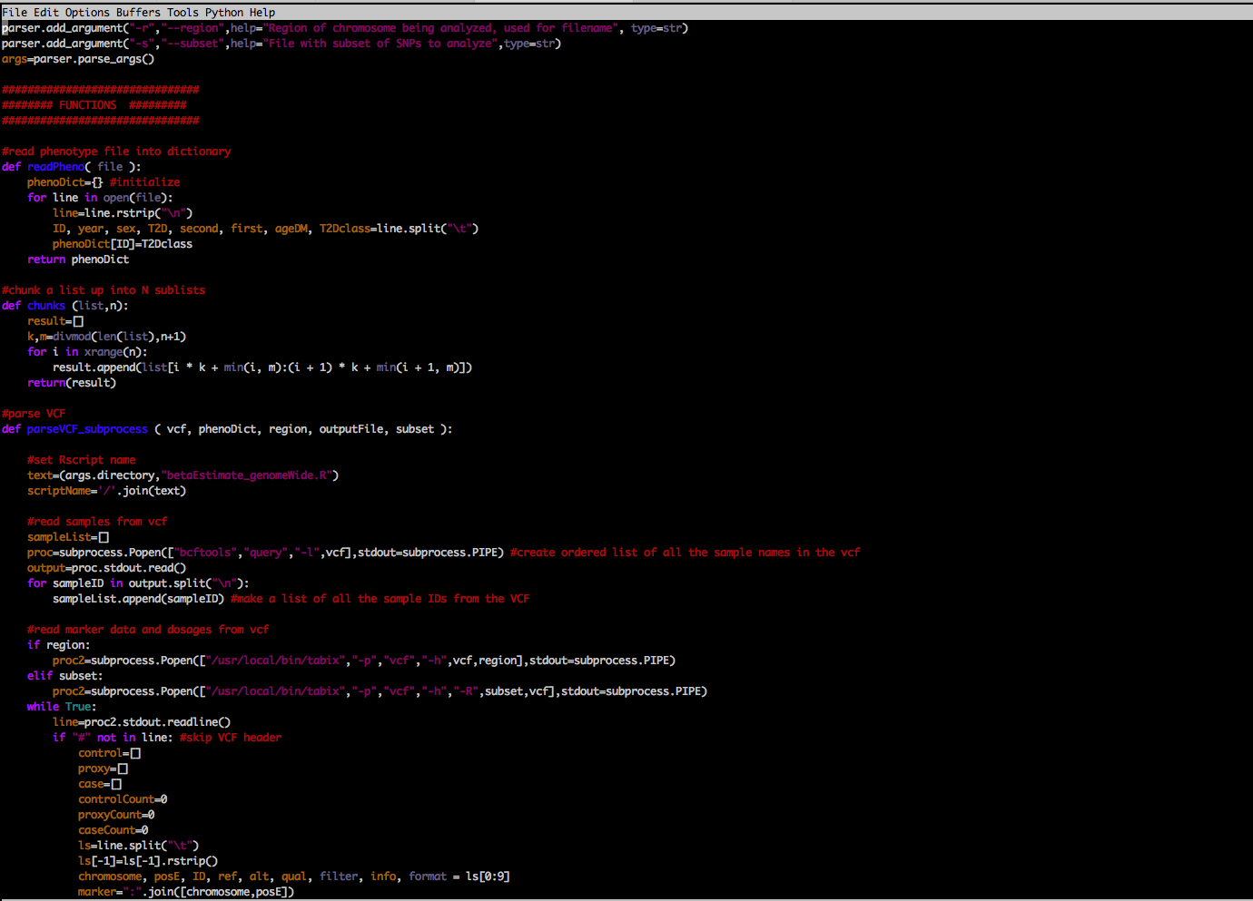
Python

Slide 7
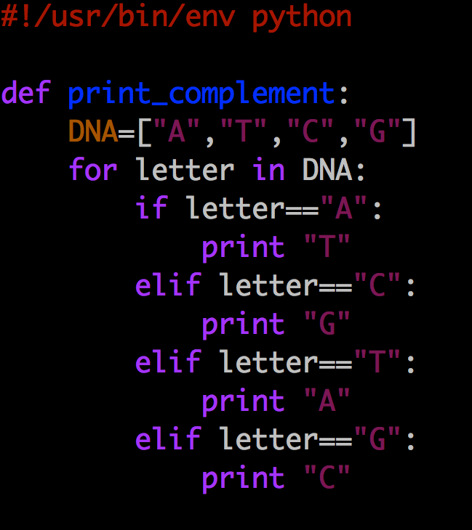

Slide 8


Boolean: binary variable with two possible values
TRUE
FALSE
Notes:
Yes or No
One or Zero
Boolean values can be represented with binary notation

Slide 9
If you like the color pink:
Put your thumb up
Else:
Put your thumb down
Notes:
Think about the binary and boolean notation in these cases

Slide 10
If you were born in Michigan:
Put your thumb up
Else:
Put your thumb down

Slide 11
If you like dogs:
Raise your right hand
Else if you like cats:
Raise your left hand
Else:
Keep your hands down
Notes:
If you like dogs AND cats you have to go to the left side of the room because liking dogs comes first--ORDER MATTERS

Slide 12
Conditional statement
If something is TRUE:
Then do something
Else if something is TRUE:
Then do something
Else:
Do something

Slide 13
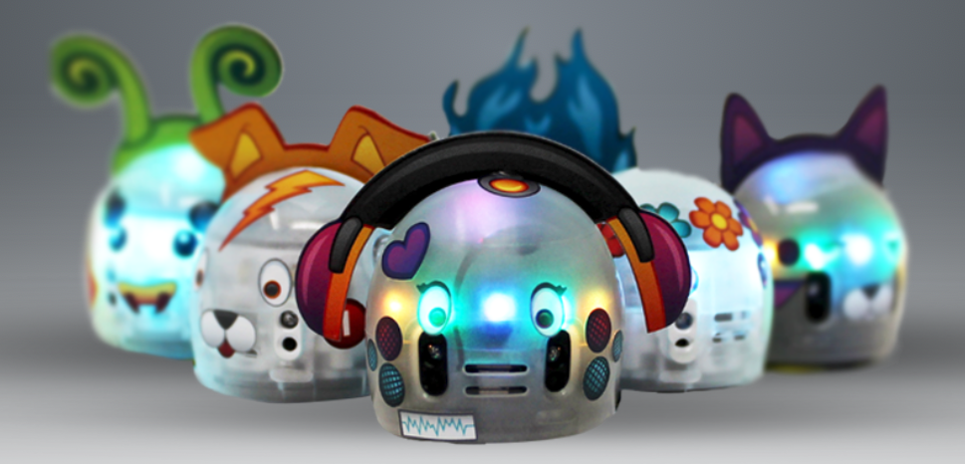
Ozobot
Ozobot.com

Slide 14

If sensor reads :
Spin around like a tornado
Else:
Continue moving forward on path

Slide 15
Goal: Turn your Ozobot into a scientist with booleans and conditional statements! Use code to: 1. Simulate Whole Exome Sequencing for genetic testing 2. Avoid pitfalls along the way!

Slide 16
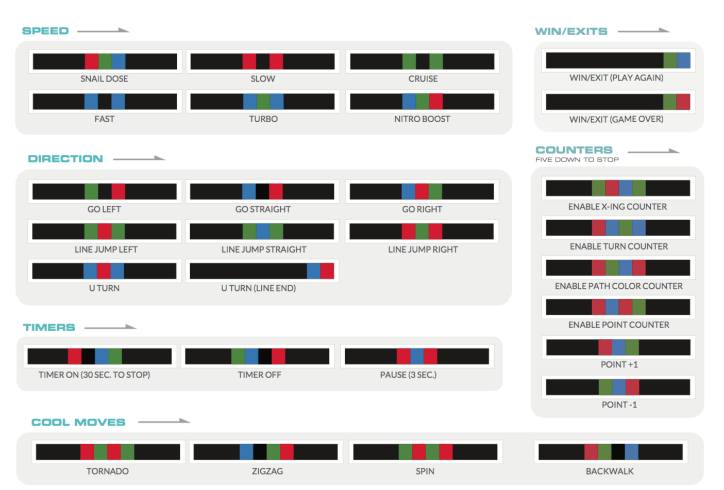
Ozocodes

Slide 17
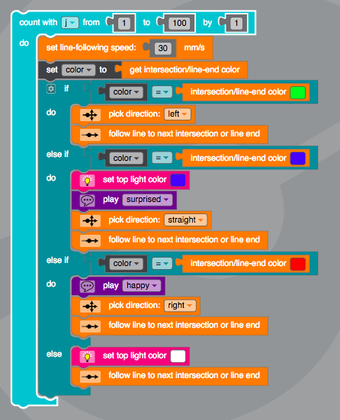

Slide 18

Email gwc.bioinfo-requests@umich.edu for information about volunteering

